Slide 1
Allergies and TGF-Beta
Cayla Guerra

Slide 2
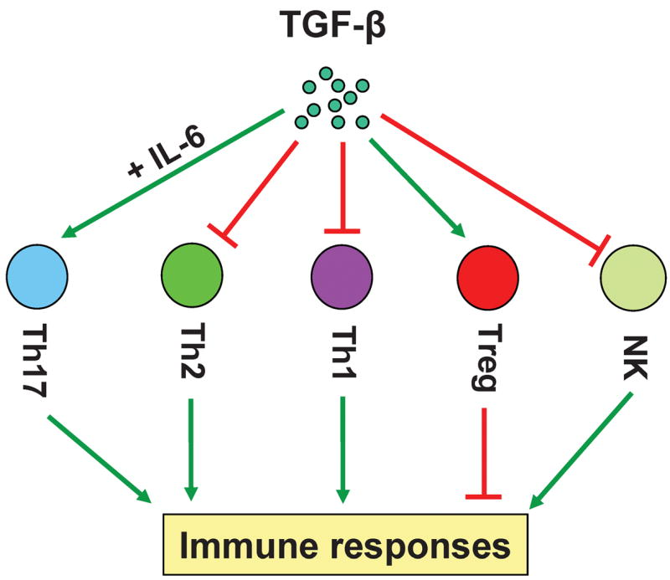
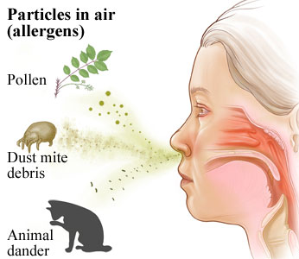
What is Allergic Rhinitis?
Notes:
http://img.webmd.com/dtmcms/live/webmd/consumer_assets/site_images/media/medical/hw/h9991456_001.jpg

Slide 3
What’s wrong with TGF-Beta in Allergic Rhinitis?
TGFB1 Propeptide
TGFB1
It’s overexpressed!

Slide 4
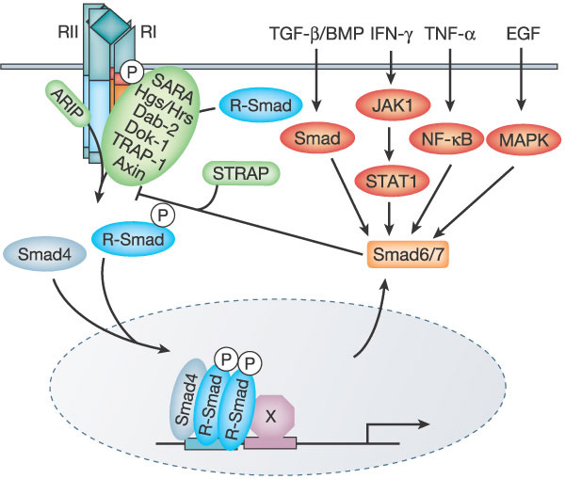
How does TGFB1 function?
Molecular Function
Biological Process
Cellular Component
TGFB1
TGFB1

Slide 5
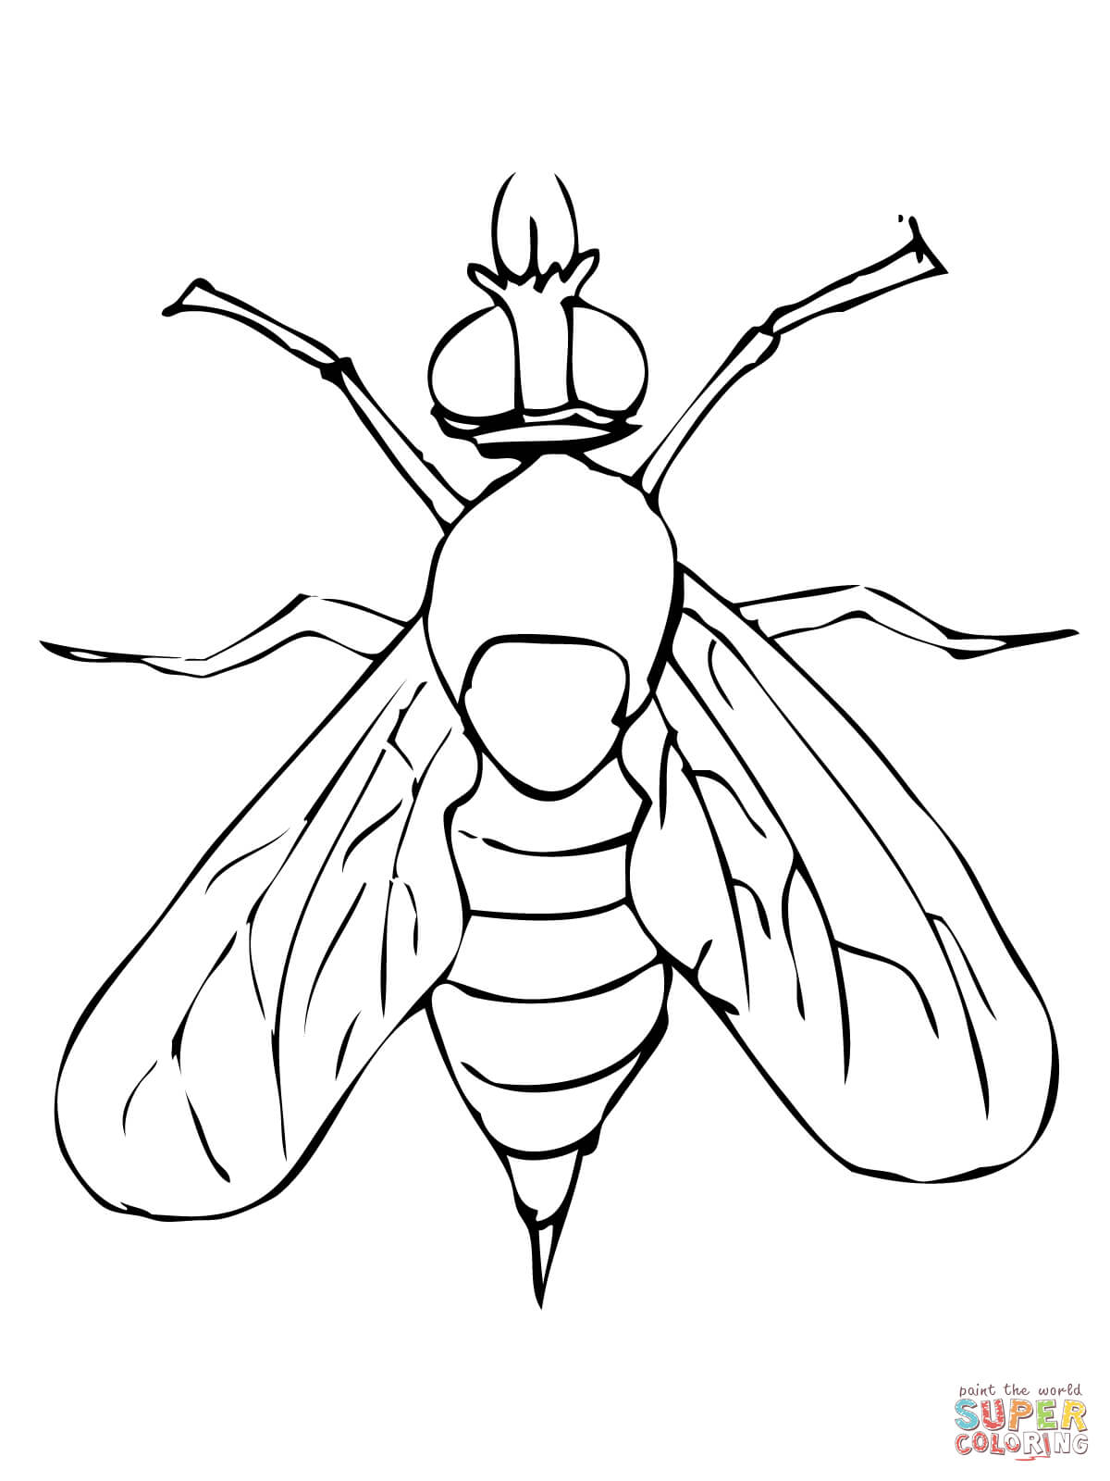
How well is TGF- beta conserved across species?
TGFB1 Propeptide
TGFB1
29
261
293
390
29
261
293
390
29
261
293
390
19
248
280
377
235
459
483
586

Slide 6
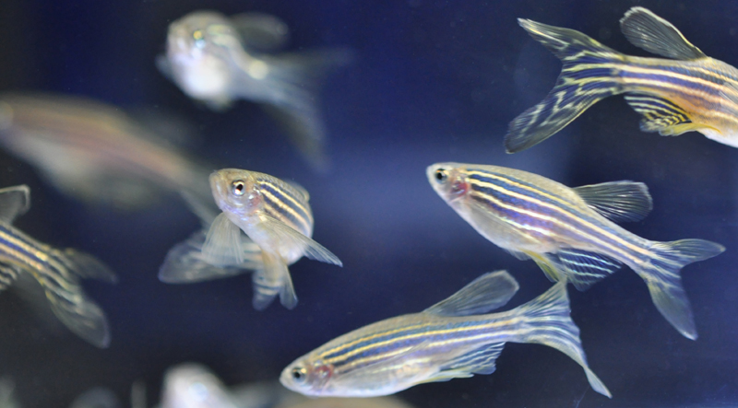
Why zebrafish?
Notes:
https://speakingofresearch.com/tag/animal-research/

Slide 7
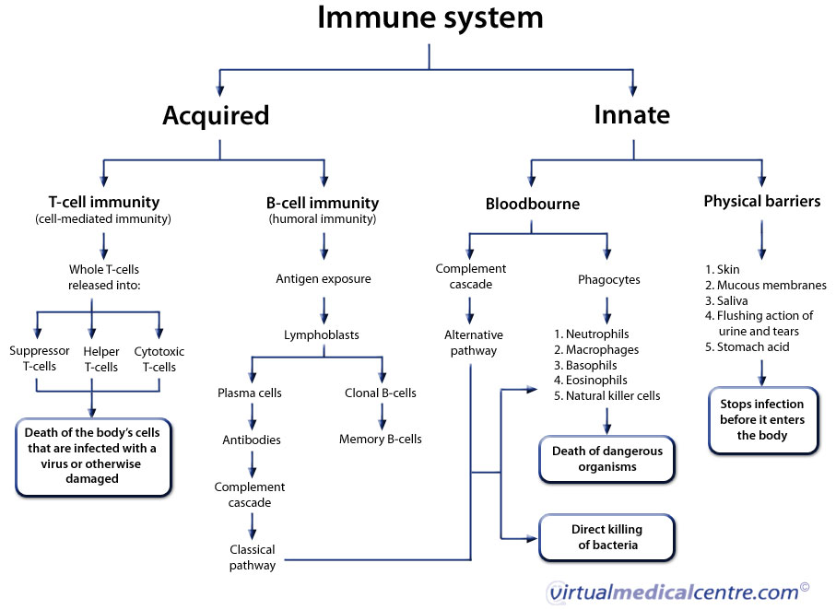
How does the human immune system work?
Notes:
https://www.google.com/imgres?imgurl=https%3A%2F%2Fwww.myvmc.com%2Fuploads%2FVMC%2FAnatomy%2FImmune_system_large.jpg&imgrefurl=https%3A%2F%2Fwww.myvmc.com%2Fanatomy%2Fhuman-immune-system%2F&docid=PmYVvuy4trJw0M&tbnid=fcJUwK5t9TFzXM%3A&vet=10ahUKEwiDlKrGn4vTAhWkxYMKHbTsAZwQMwgcKAAwAA..i&w=907&h=662&bih=662&biw=1366&q=basic%20human%20immune%20system&ved=0ahUKEwiDlKrGn4vTAhWkxYMKHbTsAZwQMwgcKAAwAA&iact=mrc&uact=8#h=662&imgrc=fcJUwK5t9TFzXM:&vet=10ahUKEwiDlKrGn4vTAhWkxYMKHbTsAZwQMwgcKAAwAA..i&w=907

Slide 8
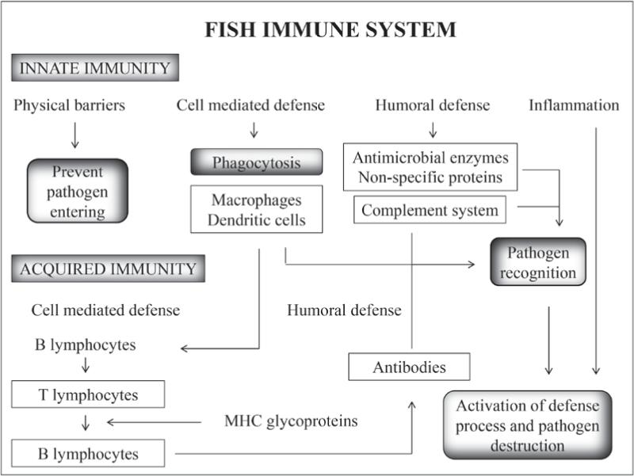
How does the zebra fish immune system work?
Notes:
http://www.scielo.br/scielo.php?script=sci_arttext&pid=S0001-37652014000301484

Slide 9
Gap in knowledge

Slide 10
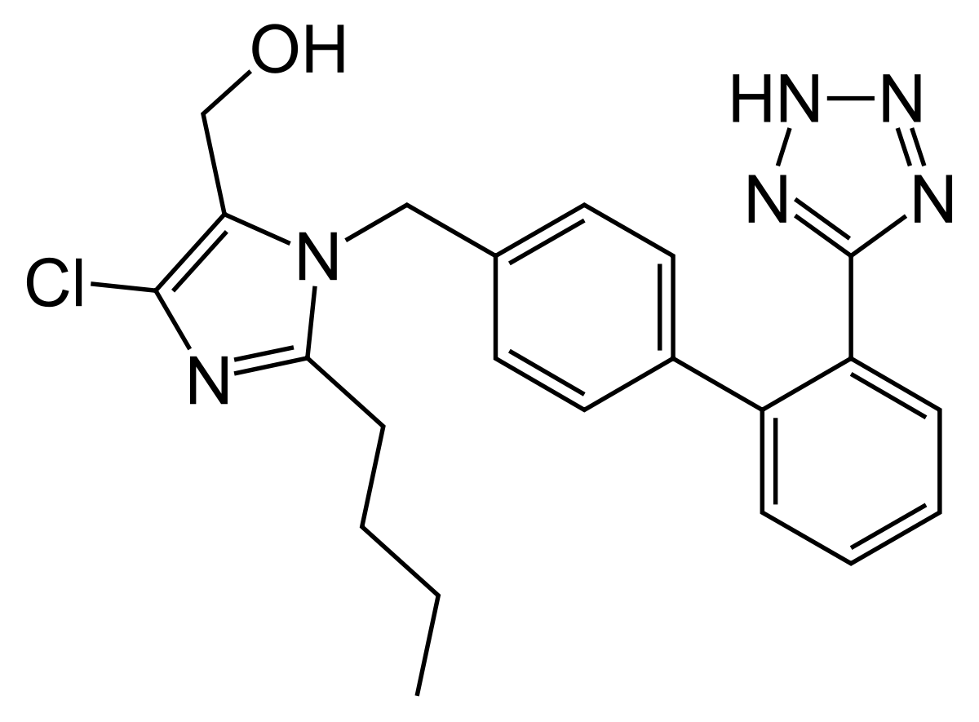
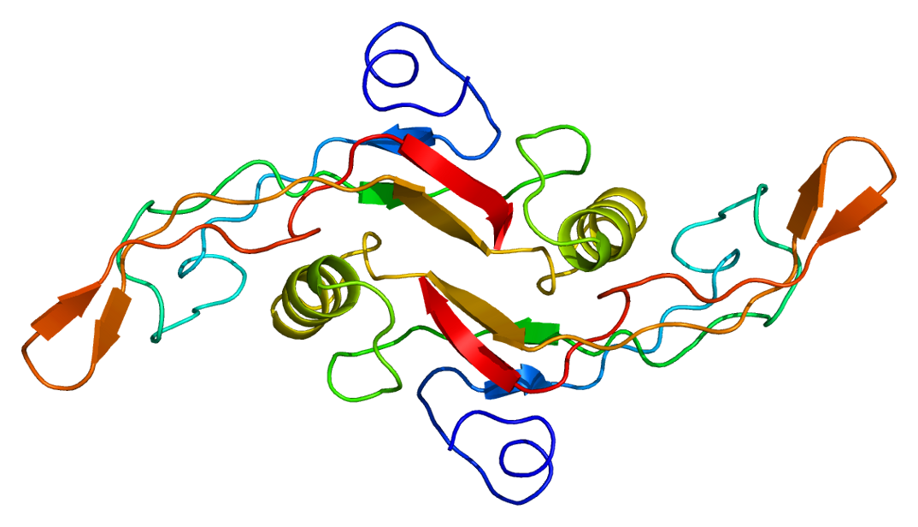
Primary Goals
Notes:
https://en.wikipedia.org/wiki/TGF_beta_1

Slide 11
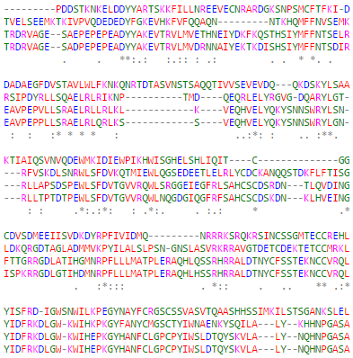
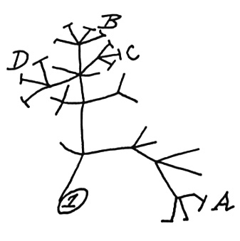
Aim 1: How does TGFB1 expression change before, during, and after an allergic reaction?
Phylogeny
Amino Acids
Compare

Slide 12
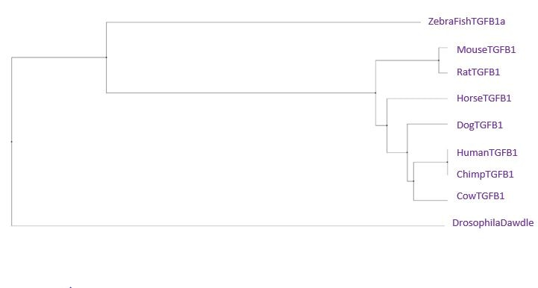
Phylogeny
Amino Acids
Compare
Notes:
https://www.kimballstock.com/results.asp?db=a&txtkeys1=finger

Slide 13
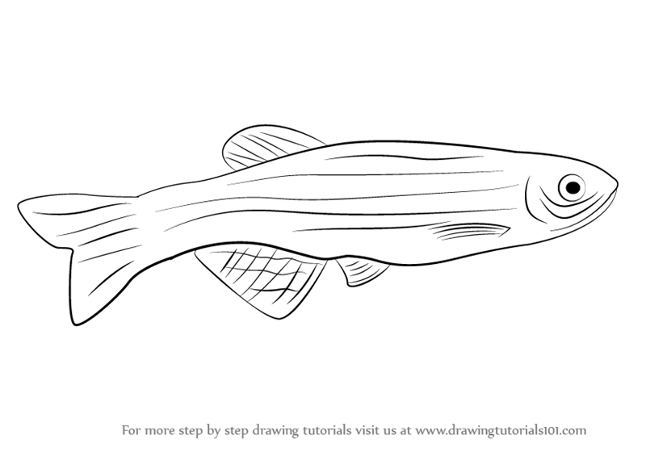
Phylogeny
Amino Acids
Compare

Slide 14
Phylogeny
Amino Acids
Compare

Slide 15
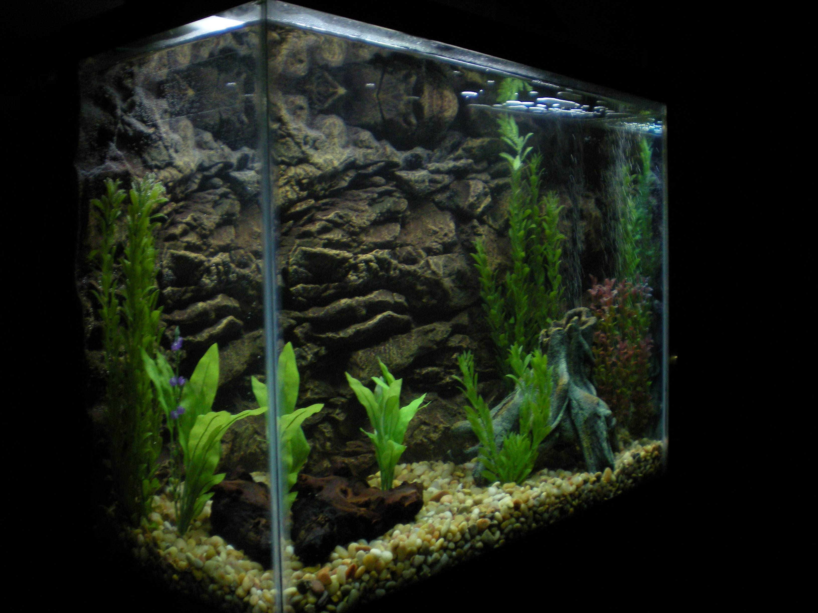
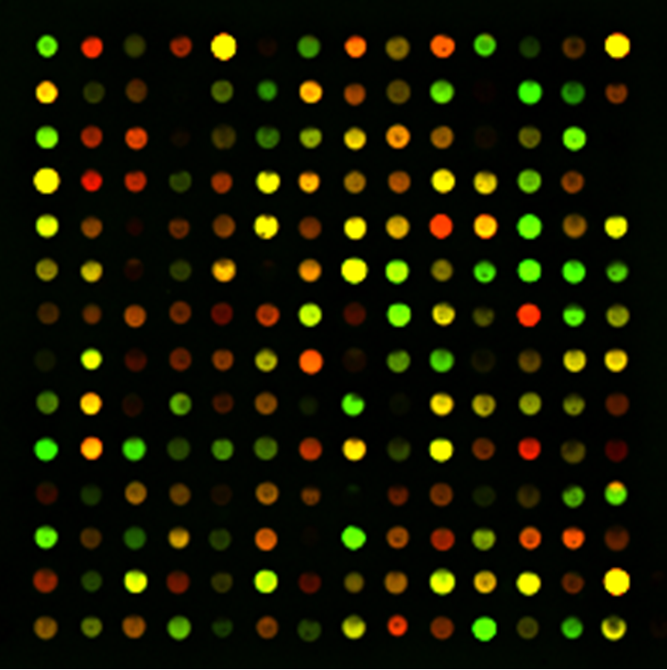
Aim 2: How does losartan change regulation of allergy related genes?
Screen
Treat
RNA-Seq
Notes:
https://prezi.com/d80eqx2gylzk/microarrays/

Slide 16
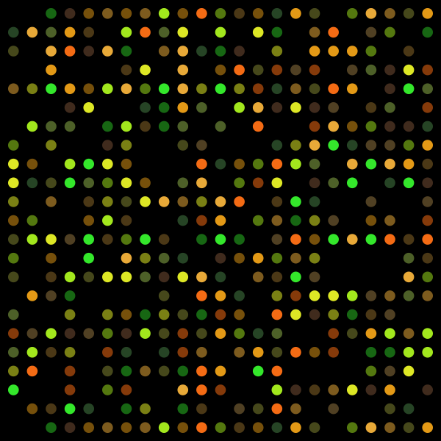
Screen
Treat
RNA-Seq

Slide 17
Screen
Treat
RNA-Seq
Notes:
https://www.123rf.com/stock-photo/zebrafish.html

Slide 18
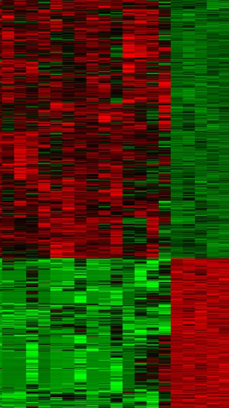
Screen
RNA-Seq
Treat

Slide 19
Refrences
[1] http://pantherdb.org/genes/gene.do?acc=HUMAN|HGNC=11766|UniProtKB=P01137
Images
[1] http://blog.oransi.com/category/allergies/
[2] http://www.dentalmcqs.com/component/k2/allergic-rhinitis
[3] https://www.ncbi.nlm.nih.gov/pmc/articles/PMC2614905/figure/F1/
[4] http://www.nature.com/nature/journal/v425/n6958/full/nature02006.html
[5] https://www.kimballstock.com/results.asp?db=a&txtkeys1=finger

