Slide 1
Allergies and TGF-Beta
Cayla Guerra

Slide 2
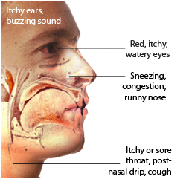
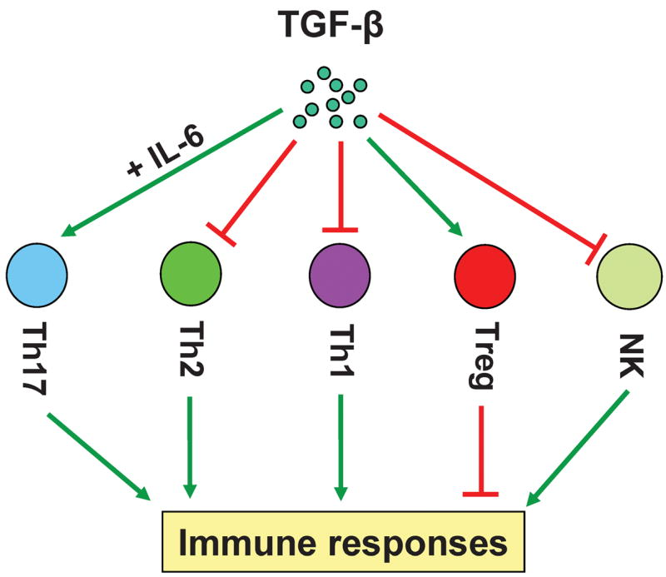
What is Allergic Rhinitis?
Red, itchy, watery eyes
Sneezing, congestion, runny nose
Itchy or sore throat, post-nasal drip, cough

Slide 3
What’s wrong with TGF-Beta in Allergic Rhinitis?
TGFB1 Propeptide
TGFB1
It’s overexpressed!

Slide 4
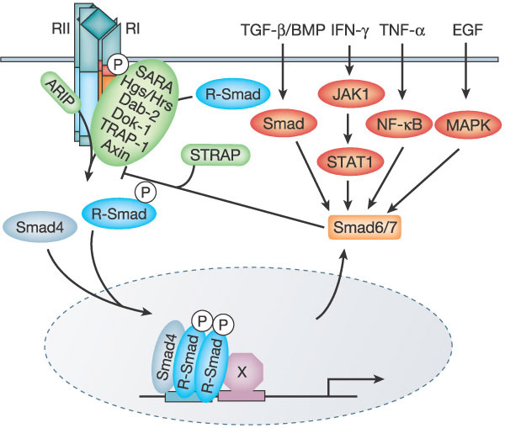
Gene Ontology
TGFB1
Molecular Function
Biological Process
Cellular Component
TGFB1
Growth Factor

Slide 5
How well is my gene conserved across species?
Humans
TGFB1 Propeptide
TGFB1
29
261
293
390
Mouse
TGFB1 Propeptide
TGFB1
29
261
293
390
Rat
TGFB1 Propeptide
TGFB1
29
261
293
390
Zebra Fish
TGFB1 Propeptide
TGFB1
19
248
280
377
Drosophila
TGFB1 Propeptide (235-459)
TGFB1 (483-586)
235
459
483
586

Slide 6
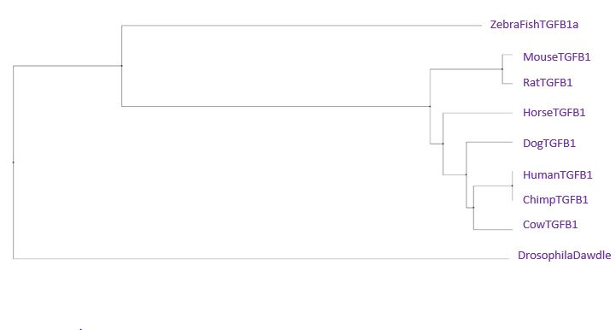
Phylogeny
Average Distance using PiD

Slide 7
Refrences
[1] http://pantherdb.org/genes/gene.do?acc=HUMAN|HGNC=11766|UniProtKB=P01137
Images
[1] http://blog.oransi.com/category/allergies/
[2] http://www.dentalmcqs.com/component/k2/allergic-rhinitis
[3] https://www.ncbi.nlm.nih.gov/pmc/articles/PMC2614905/figure/F1/
[4] http://www.nature.com/nature/journal/v425/n6958/full/nature02006.html

